Slide 1
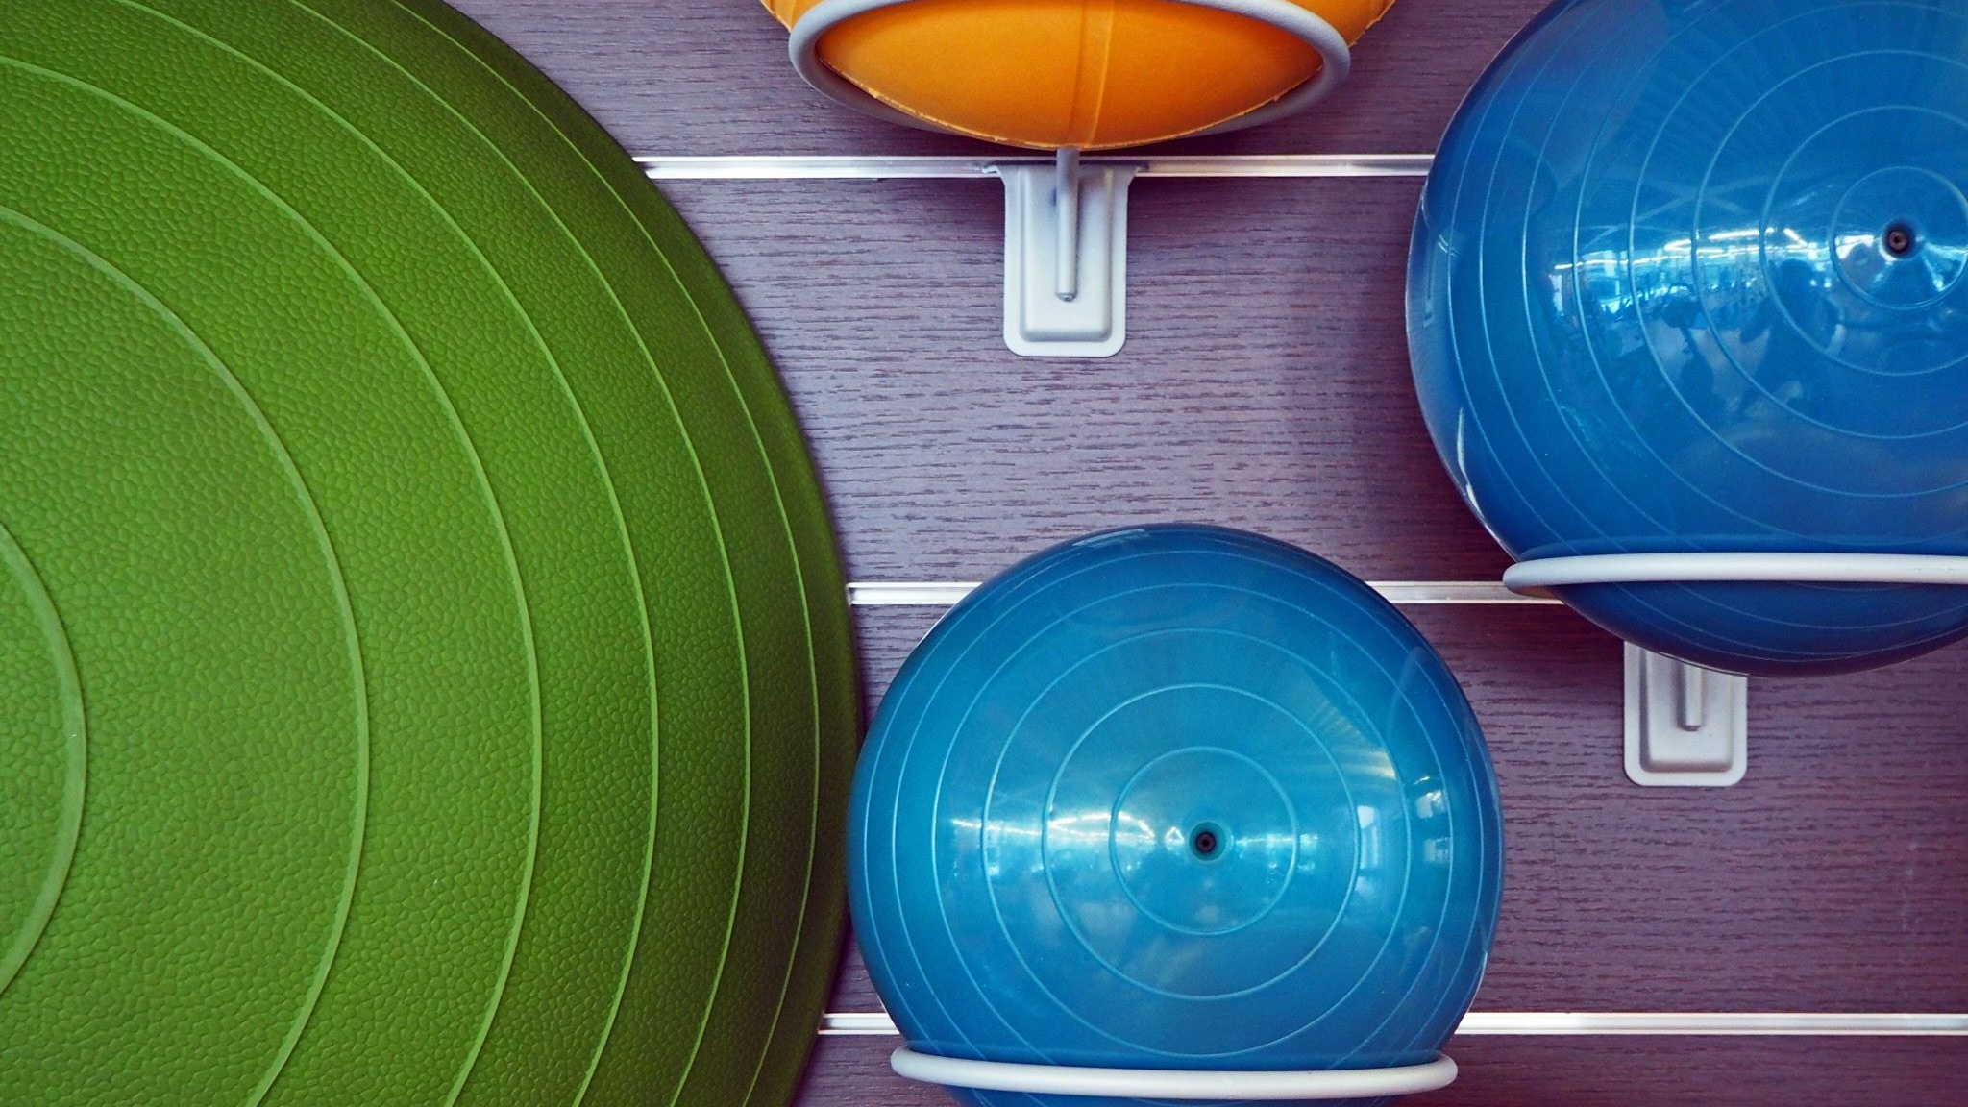
Pool Simulator
Dovydas Simkus, Bogdan sergijenko, ostin mathias, chris kerr

Slide 2
Basic Overview
There will be circles moving due to a motion inputted by the user.
The circles will bounce of one another due to physics (kinetic transfer of motion).
The circles will give points when they hit 1 of the 6 holes at the edges of the screen, the game will end when the black circle goes into the hole.
More points will be awarded depending on whether the circles are potted in the holes in one “turn”.

Slide 3
The END

